Slide 1
Bob’s Baloney
Professor Burnes
Leeds School of Business
University of Colorado Boulder
Leeds
B U S I N E S S
Page 1

Slide 2
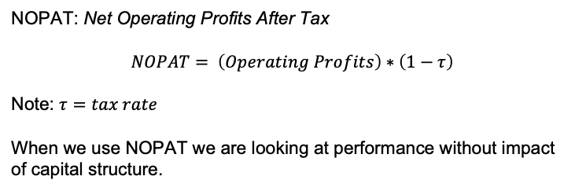
FIN CALC NOTE
NOPAT: Net Operating Profits After Tax
$$NOPAT= \left(Operating Profits\right)∗\left(1−τ\right)$$
Note: $τ=tax rate$
When we use NOPAT we are looking at performance without impact of capital structure.

Slide 3
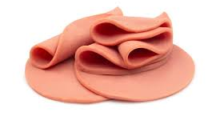
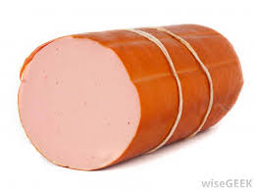
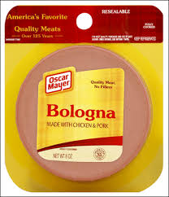
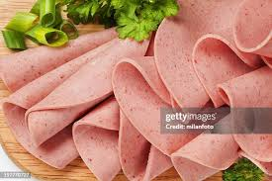
Baloney (aka Bologna)

Slide 4
History….
1920’s Bob’s Founded in Philadelphia by Slovenian Immigrant, Bob Klobase
Crafts bologna at the very highest level
Has greater than 50% of High End Market Share

Slide 5
… and where we are now
2017 New Green Hills Facility Investment plus apparent additional machinery investments since then for ~ $200M
TODAY, early 2020
Veronica Mino, Managing Director of Diaz Internacional, an Argnentine food conglomerate that owns 30% of the equity shares in Bobs has made public her displeasure with Bobs

Slide 6
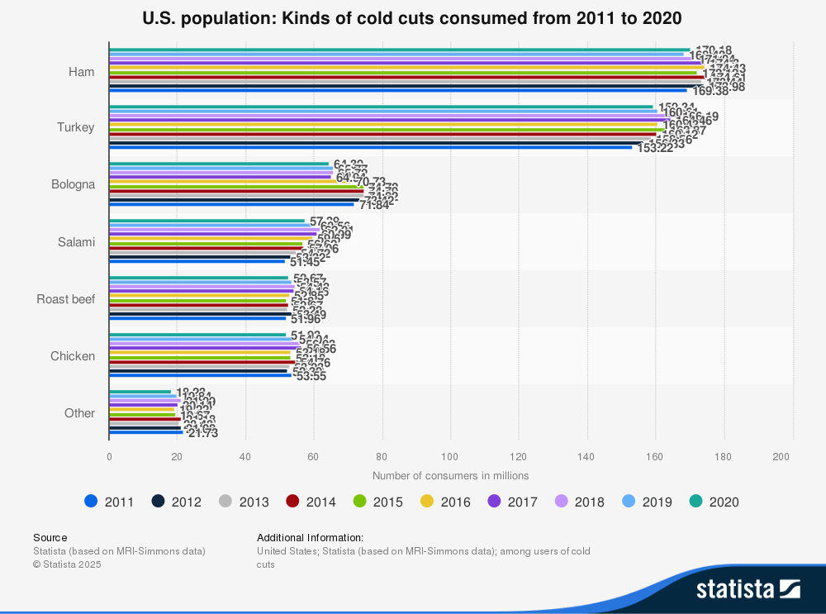
Some Background and Market Insight

Slide 7
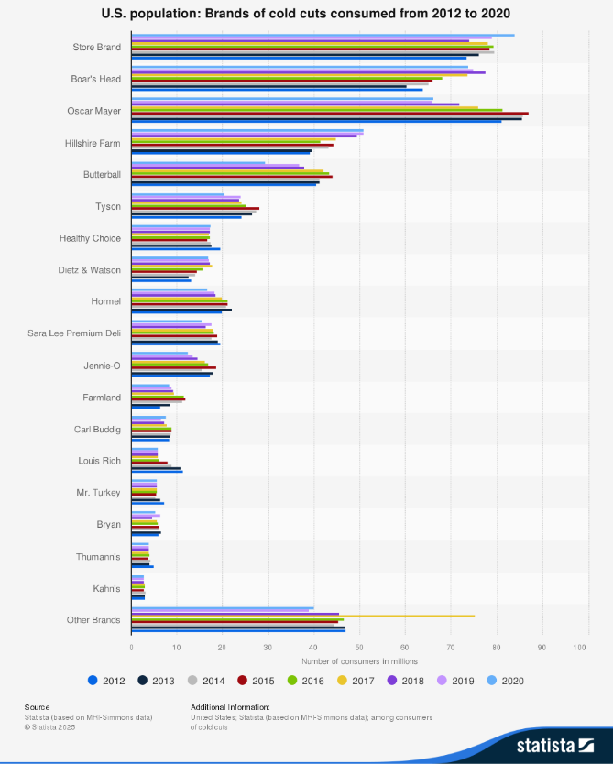
What is the implication of this Brands Summary for Bob?

Slide 8
3 Teams, within each Team, 3 groups (see spreadsheet for each of you)
Bob’s
Spangler
Mino
Scorecard
Other Values
DuPont Elements Over Time
DuPont Ratio Over Time
Cap Structure
Coverage
Comps – Bob’s position over time
Fin Trends
Return Metrics

Slide 9
Question: What was Bob’s management’s goal/objective with the new facility
Bob’s
For Example:
Our plan is working! Revenue is Increasing!
How to evaluate success relative to goal?

Slide 10
Bob’s Values
Bob’s
This is a Scorecard.
Feel Free to Modify.
As a result of your insight gained by understanding Bob’s values, what do you suggest may be happening?

Slide 11
Bob Valuation Tab
Bob’s
While we don’t know when Mino bought 30% of the equity shares, let’s imagine that she did it in 2015.
If Mino valued Bob’s at a 3xmultiple of NOPAT, how much was Bob’s worth in 2015?
What was her 30% worth. This would be considered AUM.
Using same methods, what is her share worth in 2019?
What is her gain/loss on this endeavor?

Slide 12
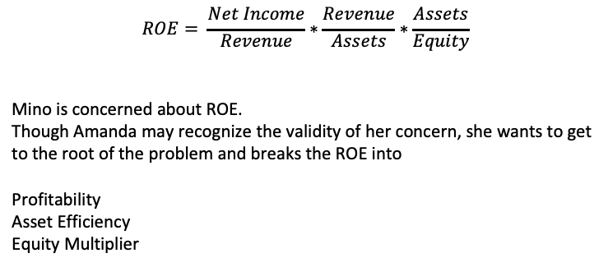
Recall the Dupont Ratio
Spangler
$$ROE= \frac{Net Income}{Revenue}∗\frac{Revenue}{Assets}∗\frac{Assets}{Equity}$$
Mino is concerned about ROE.
Though Amanda may recognize the validity of her concern, she wants to get to the root of the problem and breaks the ROE into
Profitability
Asset Efficiency
Equity Multiplier

Slide 13
DuPont Page – Spangler’s Analysis
Spangler
Build out the Dupont Elements and correspondingly ROE
What is driving ROE?
What is the implication of the Asset Efficacy calculation?
Finally, consider Liquidity and Coverage Ratios.
Prepare to report findings to team – think about headlines like:
”In 2015 Bobs had 13.7% net profitability and a TIE ratio of 37.8
While in 2019, Bobs has 2% net profitability and 2.27 TIE ratio.

Slide 14
Recall the power of the Dupont Ratio
Spangler
And give an insight/recommendation on:
Operations
Asset Efficiency
Capital Structure
?? How can you tell Mina that you know what to do to fix this problem

Slide 15
Comps Analysis
Mino
Set the stage with the Comps.
Show Where Bob fit in 2015 and now in 2019
Prepare to give a Tough Bottom Line

Slide 16
Mino Return Metrics
Mino
Complete the Table for:
ROA
Rev/Assets
Rev/PPE (distinguish PPE from Total Assets!!)
ROSGA (this is Return on SGA as measured by Net Income(Profits))
Recall Bob’s reputation for fabulous Marketing campaigns
If you are Mino, what questions do you have/what changes are you going to ‘demand’

Slide 17
So, Where are We
Team Bob Update
Team Spangler Update
Team Mino Update

Slide 18
Mino’s Comments… and framing the response
Does Financial Performance Matter? – what do you want to see?
Is the powerhouse brand making money? How might you reframe Mino’s assertion/question? How might you measure performance accordingly?
What is a decent return? – we won’t do this calculation today, but what might some elements be that you would include in this calculation? – consider impact of leverage here
How might you respond to her decent return comment based on the Comps Eval?

Slide 19
Recommendations?

Slide 20
Outcomes/Insights
WHAT has fallen regarding Financial Performance?
Be careful to look at trends relative to consistent base… eg, profits as a function of Revenue (% rather than whole number)
Is ROE enough? What is the implication of the Equity Multiplier in Bob’s results.
They may have over-invested in the new plant/capabilities. (see ROA tab in particular) Could they have staged the growth differently? Financed it differently? Did they mis-judge development of high end MARKET SIZE?

Slide 21
Wednesday
Company Formation
Legal Structure
Capital Structure
Risk
Growth

